Slide 1
Tweet API
Username
Laila Ben
Password
**********
OK
Cancel
Forgot Password?

Slide 2
Tweet API
Enter The Key words :
Add New
OK
Reset
Export CSV

Slide 3
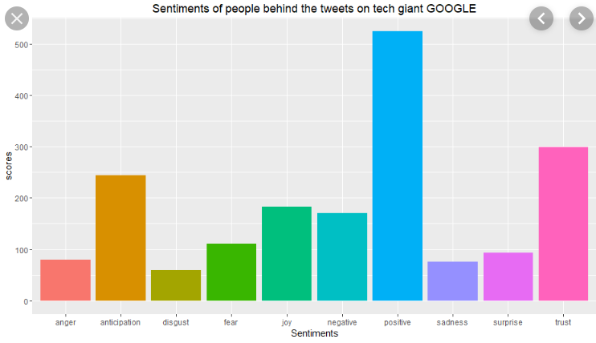

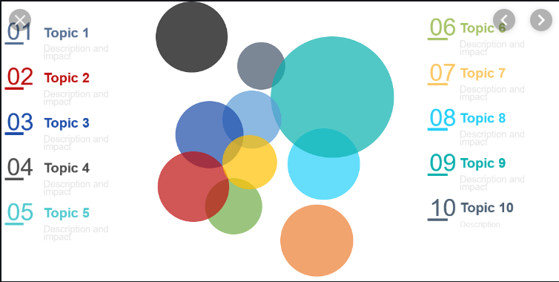
Tweet API - Analysis

